Slide 1
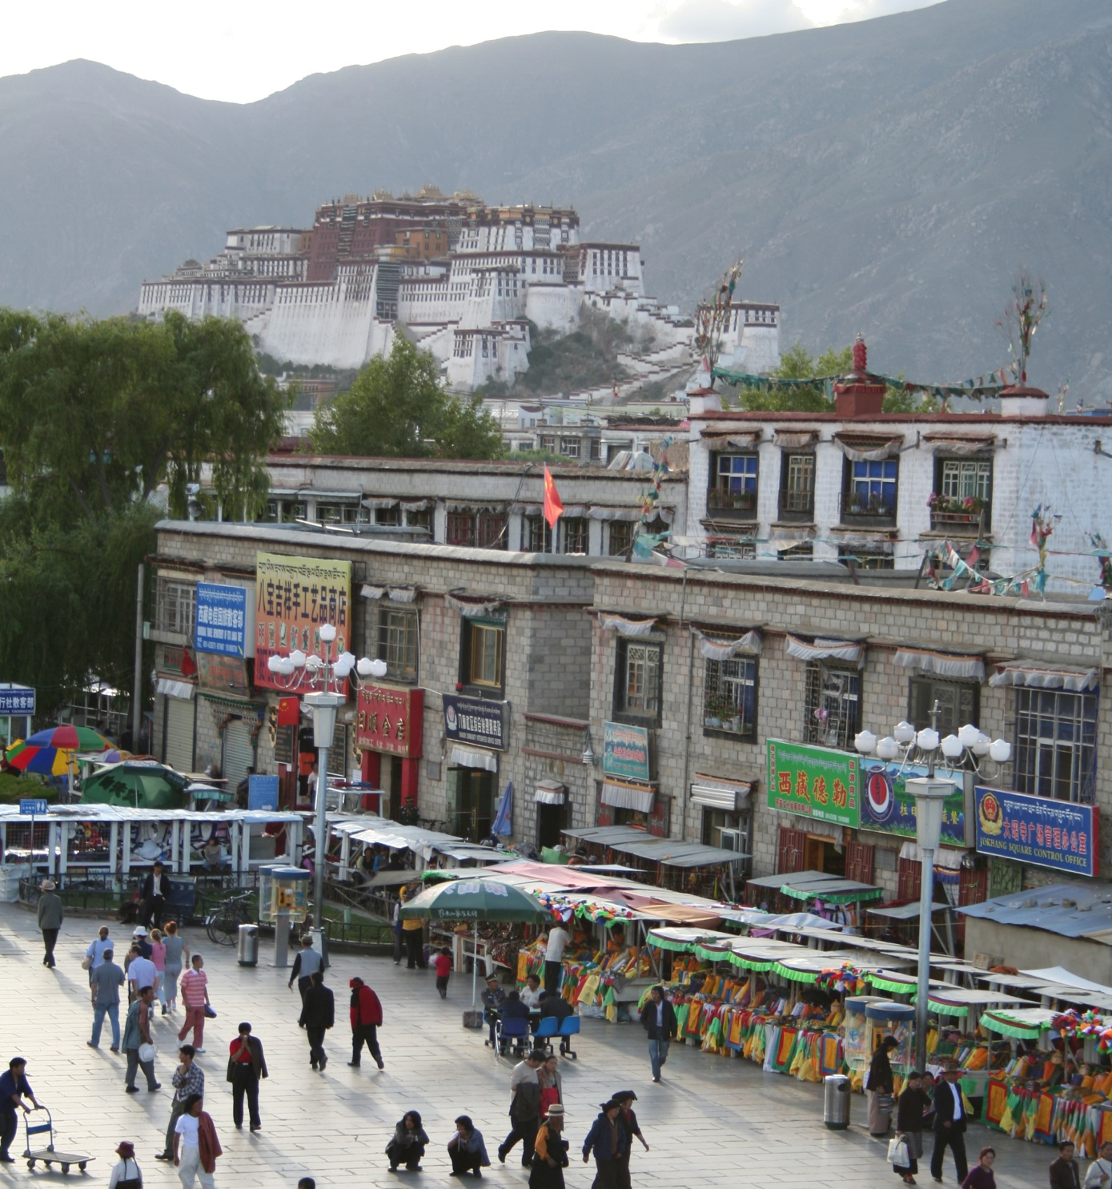
Introduction to Recognition
CS5670: Intro to Computer Vision
Noah Snavely
mountain
tree
building
banner
street lamp
vendor
people

Slide 2
Announcements
Project 4 (Stereo) has been released (demo)
Due next Friday, April 28, by 11:59pm
To be done in pairs

Slide 3
Where we go from here
What we know: Geometry
What is the shape of the world? How does that shape appear in images?
What’s next: Recognition
What are we looking at?

Slide 4
What do we mean by “object recognition”?
Next 15 slides adapted from
Li, Fergus, & Torralba’s excellent short course on category and object recognition

Slide 5
Verification: is that a lamp?

Slide 6
Detection: are there people?

Slide 7
Identification: is that Potala Palace?

Slide 8
Object categorization
mountain
tree
building
banner
street lamp
vendor
people

Slide 9
Scene and context categorization
outdoor
city
…

Slide 10
Activity / Event Recognition
what are these people doing?

Slide 11
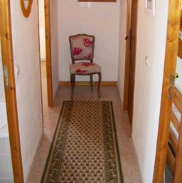

Object recognition Is it really so hard?
Find the chair in this image
Output of normalized correlation
This is a chair

Slide 12
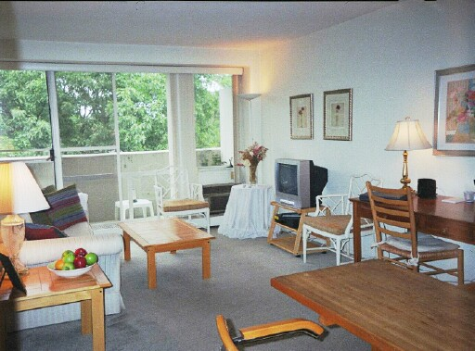
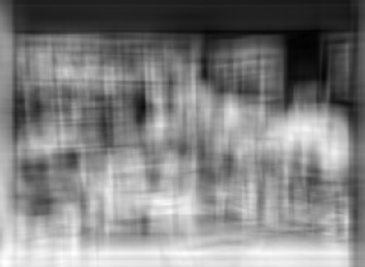
Object recognition Is it really so hard?
Find the chair in this image
Pretty much garbage
Simple template matching is not going to make it

Slide 13
Object recognition Is it really so hard?
Find the chair in this image
A “popular method is that of template matching, by point to point correlation of a model pattern with the image pattern. These techniques are inadequate for three-dimensional scene analysis for many reasons, such as occlusion, changes in viewing angle, and articulation of parts.” Nivatia & Binford, 1977.

Slide 14
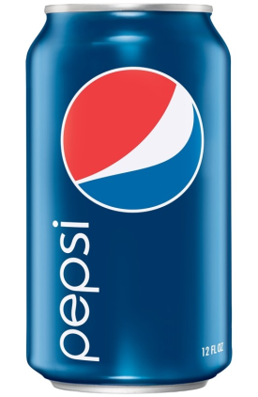

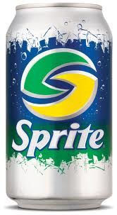
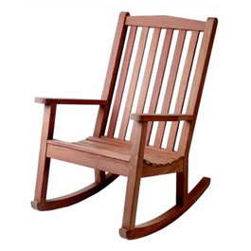
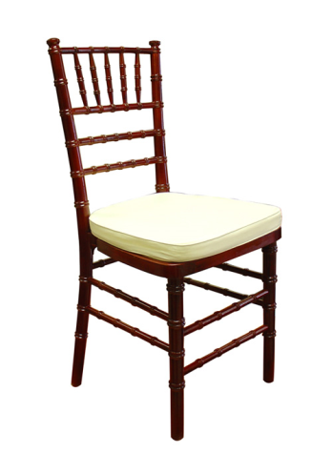
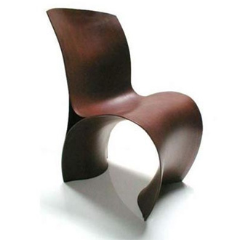
Why not use SIFT matching for everything?
Works well for object instances
Not great for generic object categories

Slide 15
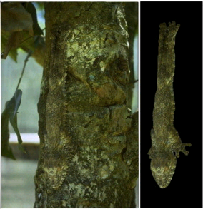
And it can get a lot harder
Brady, M. J., & Kersten, D. (2003). Bootstrapped learning of novel objects. J Vis, 3(6), 413-422

Slide 16
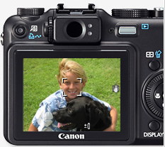
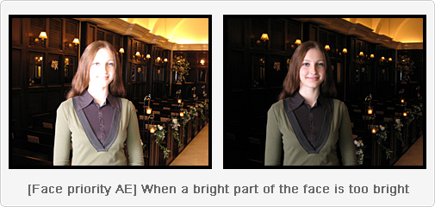
Applications: Computational photography

Slide 17
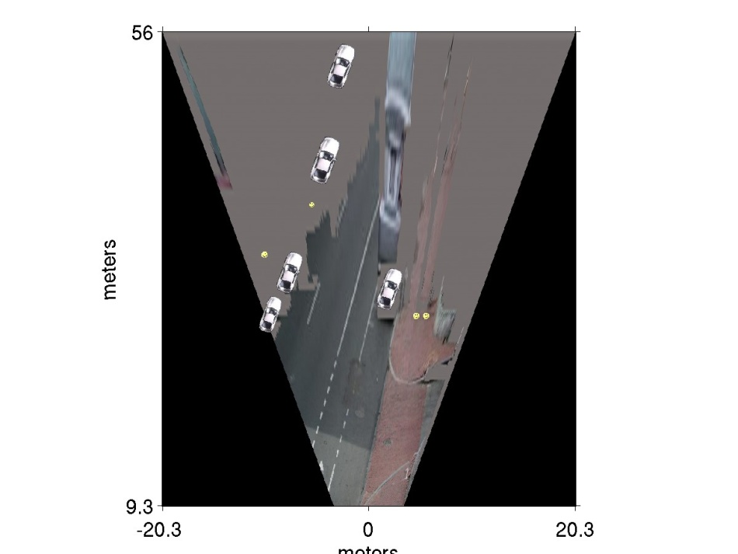
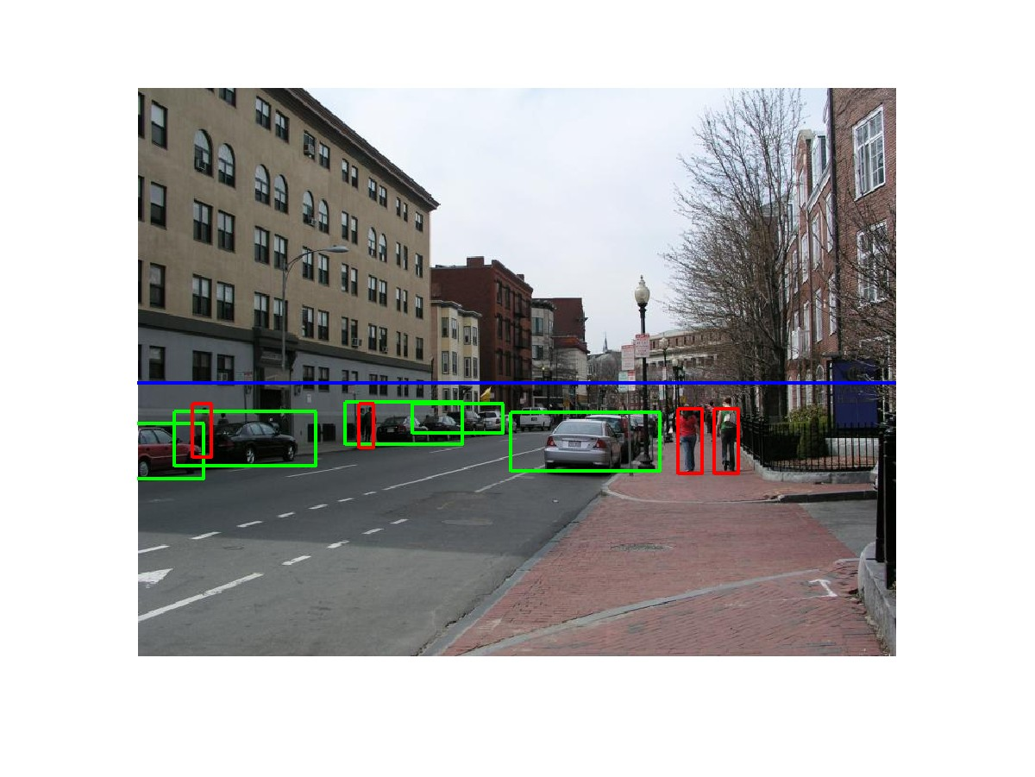
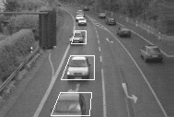
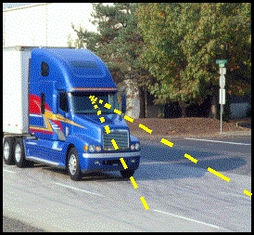
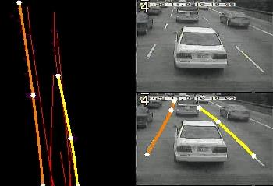
Applications: Assisted driving
Pedestrian and car detection
meters
Ped
Ped
Car
meters
Lane detection
Collision warning systems with adaptive cruise control,
Lane departure warning systems,
Rear object detection systems,

Slide 18
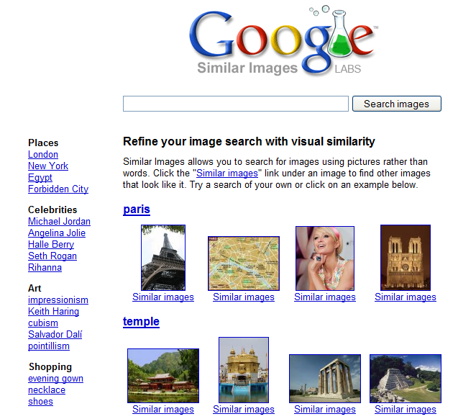
Applications: image search

Slide 19
How do human do recognition?
We don’t completely know yet
But we have some experimental observations.

Slide 20
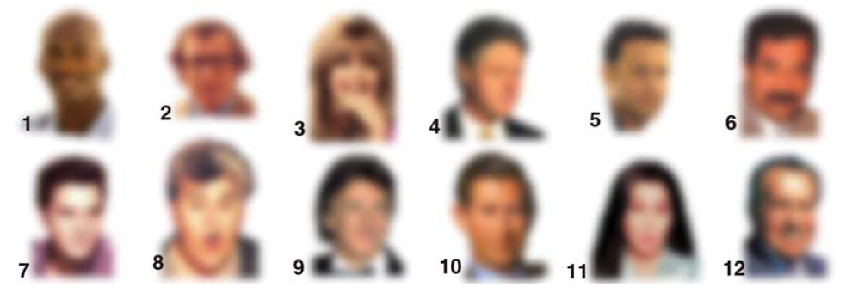
Observation 1
We can recognize familiar faces even in low-resolution images

Slide 21
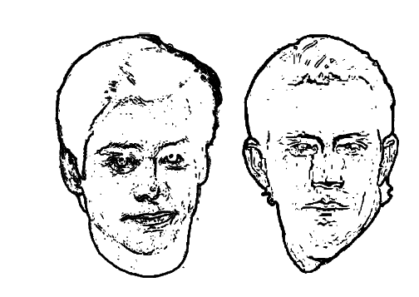
Observation 2:
Jim Carrey
Kevin Costner
High frequency information is not enough

Slide 22
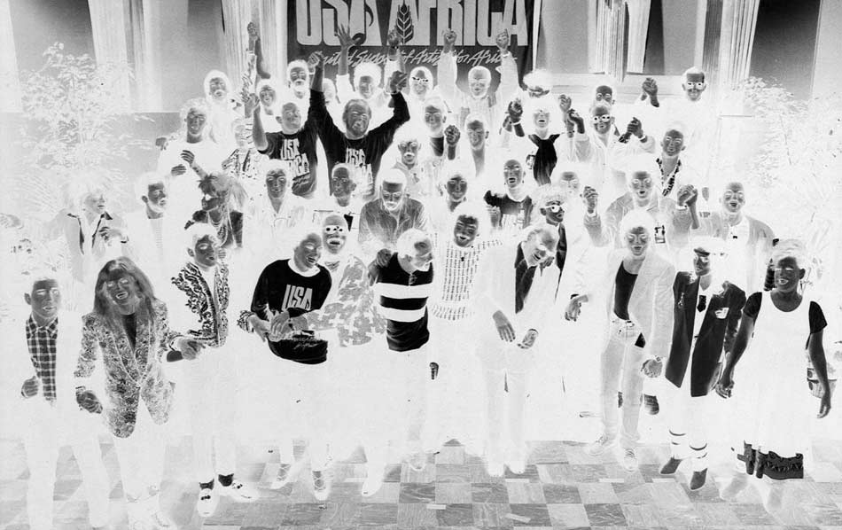
Observation 3:

Slide 23
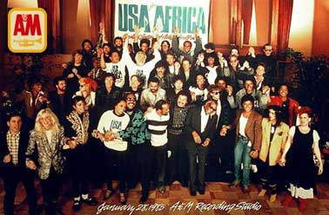
Observation 3:
Negative contrast is difficult

Slide 24
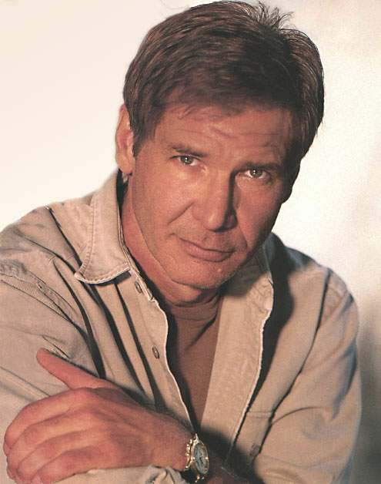
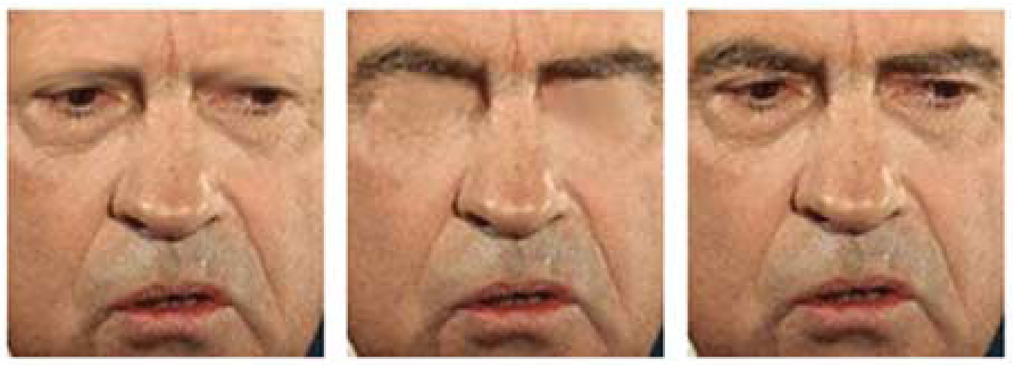
What is the single most important facial features for recognition?

Slide 25
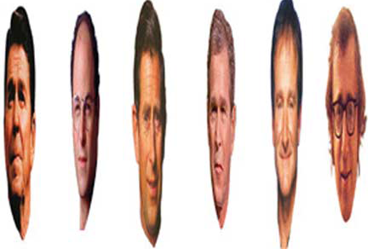
Observation 4:
Image Warping is OK

Slide 26
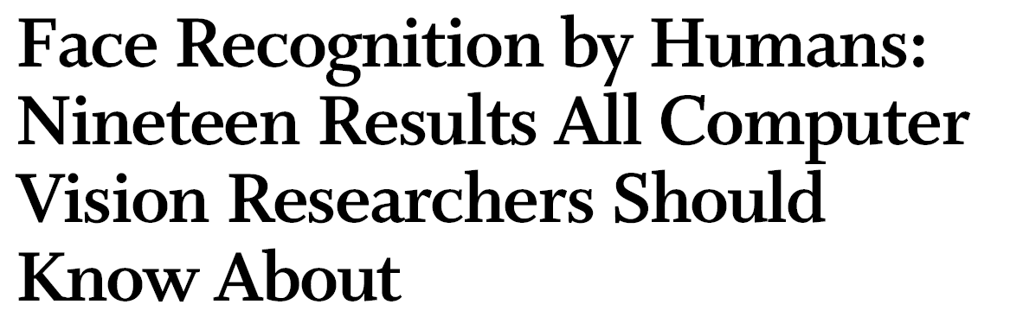
The list goes on
http://web.mit.edu/bcs/sinha/papers/19results_sinha_etal.pdf

Slide 27
Why is this hard?
Variability:
Camera position
Illumination
Shape parameters
Svetlana Lazebnik
Notes:
One could argue that invariance is the key challenge to computer vision. But is this still true with big data?

Slide 28
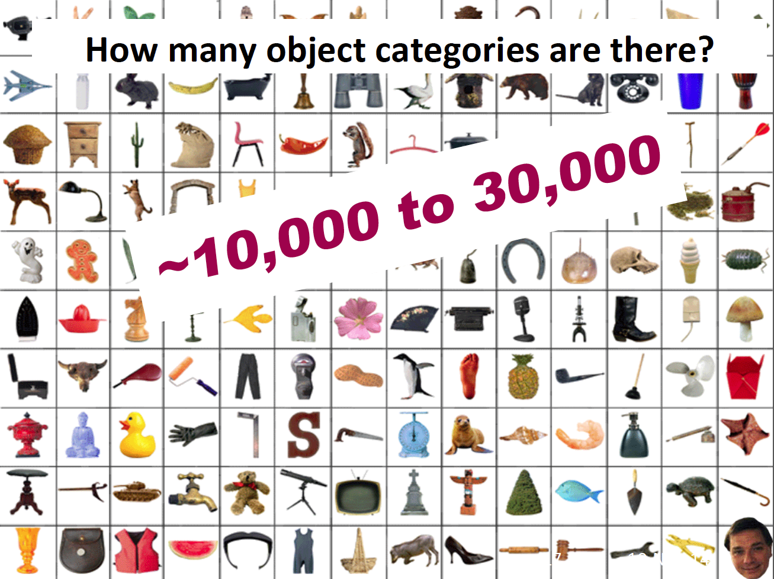

Slide 29
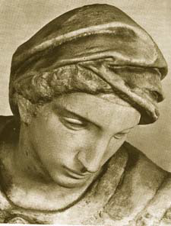
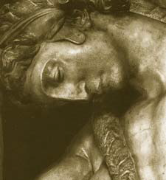
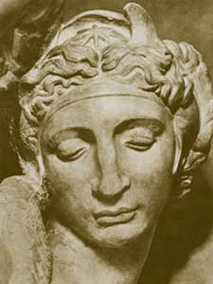
Challenge: variable viewpoint
Michelangelo 1475-1564

Slide 30
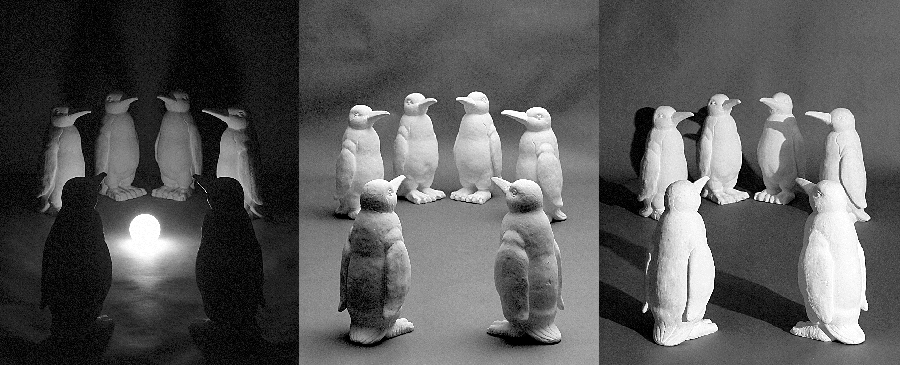
Challenge: variable illumination
image credit: J. Koenderink

Slide 31
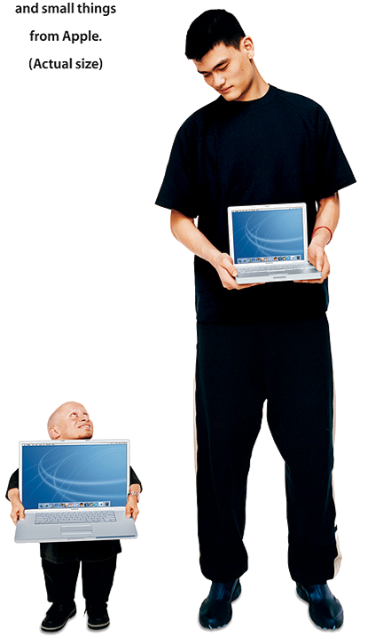
Challenge: scale

Slide 32
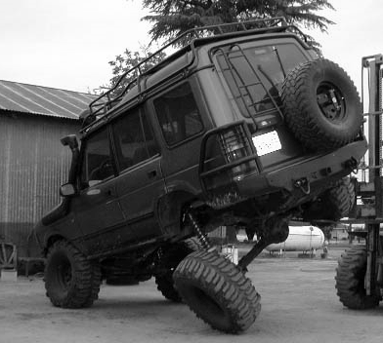
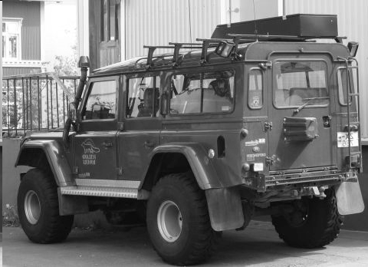
Challenge: deformation

Slide 33
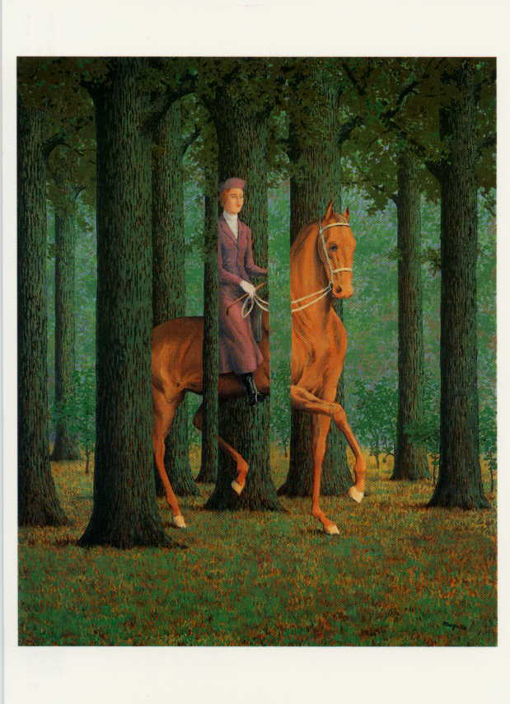
Challenge: Occlusion
Magritte, 1957

Slide 34
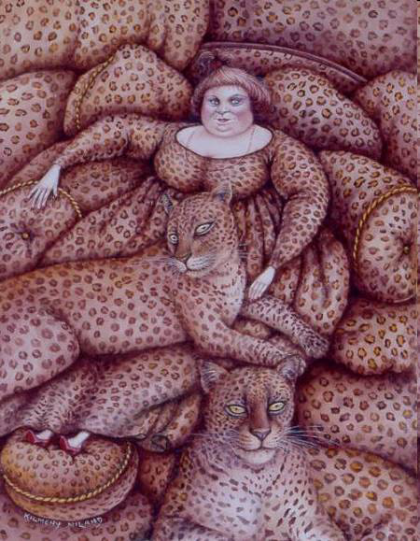
Challenge: background clutter
Kilmeny Niland. 1995

Slide 35
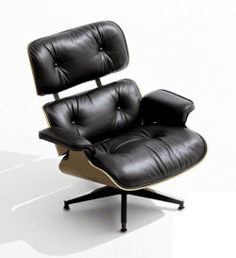
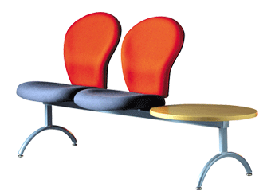
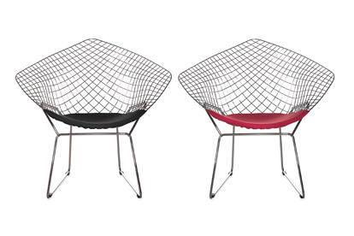
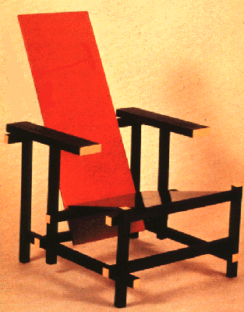
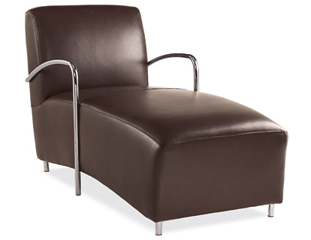
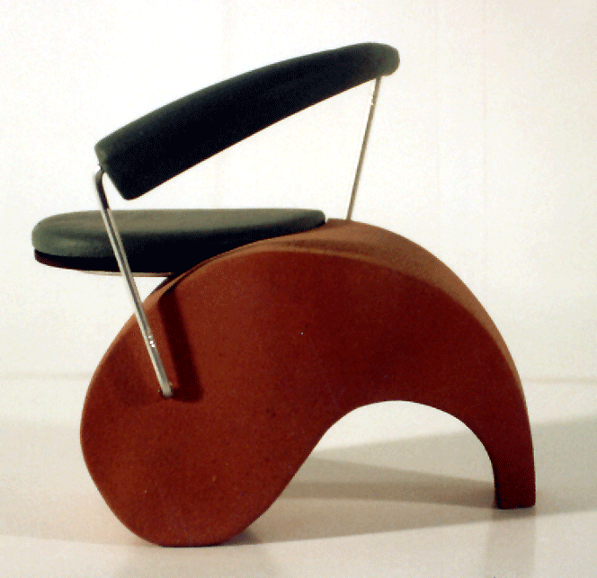
Challenge: intra-class variations
Svetlana Lazebnik
Notes:
Note English language issues. Try to not let language confound things.

Slide 36
History of ideas in recognition
1960s – early 1990s: the geometric era
Svetlana Lazebnik

Slide 37
θ
Variability:
Camera position
Illumination
Alignment
Shape: assumed known
Roberts (1965); Lowe (1987); Faugeras & Hebert (1986); Grimson & Lozano-Perez (1986); Huttenlocher & Ullman (1987)
Svetlana Lazebnik

Slide 38
Instance Recognition
Alignment: fitting a model to a transformation between pairs of features (matches) in two images
x_{i}
x_{i}
Find transformation T that minimizes
'
T
Svetlana Lazebnik

Slide 39
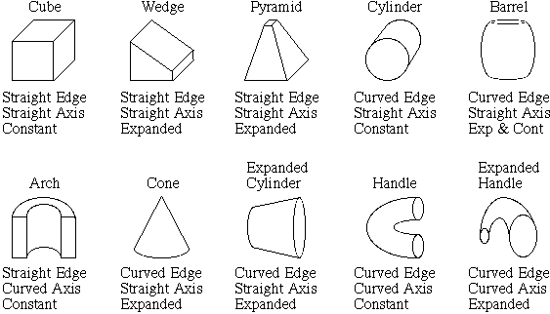
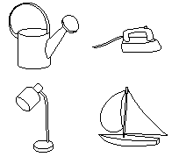
Recognition by components
Biederman (1987)
Primitives (geons)
Objects
http://en.wikipedia.org/wiki/Recognition_by_Components_Theory
Svetlana Lazebnik

Slide 40
History of ideas in recognition
1960s – early 1990s: the geometric era
1990s: appearance-based models
Svetlana Lazebnik

Slide 41
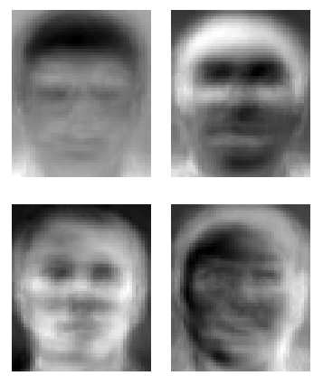
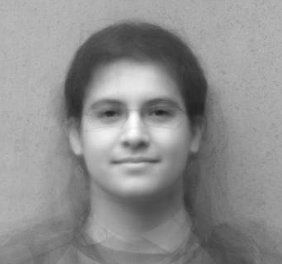
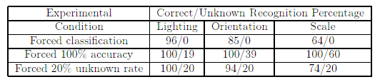
Eigenfaces (Turk & Pentland, 1991)
Svetlana Lazebnik
Notes:
An image can be compressed and reconstructed by starting from the mean, and adding a small number of scaled signed images. The scaled signed images come from doing PCA (or eigenvalue analysis) and adding the eigenfaces.

Slide 42
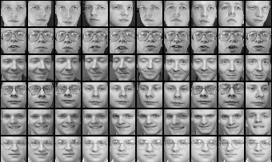
Limitations of global appearance models
Requires global registration of patterns
Not robust to clutter, occlusion, geometric transformations
Svetlana Lazebnik

Slide 43
History of ideas in recognition
1960s – early 1990s: the geometric era
1990s: appearance-based models
1990s – present: sliding window approaches
Svetlana Lazebnik

Slide 44
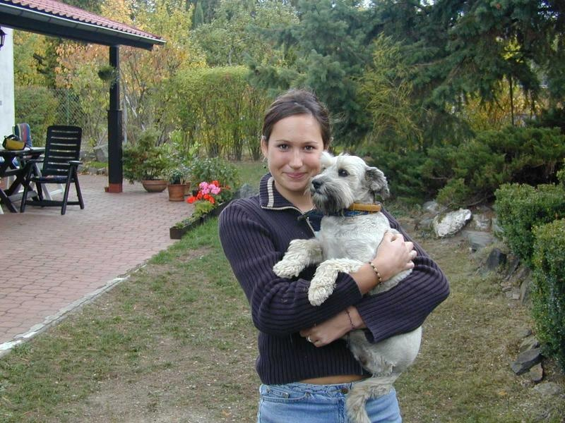
Sliding window approaches

Slide 45
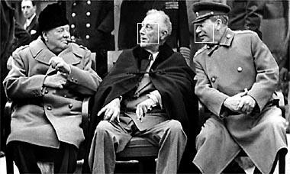
Sliding window approaches
Turk and Pentland, 1991
Belhumeur, Hespanha, & Kriegman, 1997
Schneiderman & Kanade 2004
Viola and Jones, 2000
Schneiderman & Kanade, 2004
Agrawal and Roth, 2002
Poggio et al. 1993

Slide 46
History of ideas in recognition
1960s – early 1990s: the geometric era
1990s: appearance-based models
Mid-1990s: sliding window approaches
Late 1990s: local features
Svetlana Lazebnik

Slide 47






Local features for object instance recognition
D. Lowe (1999, 2004)

Slide 48
History of ideas in recognition
1960s – early 1990s: the geometric era
1990s: appearance-based models
Mid-1990s: sliding window approaches
Late 1990s: local features
Early 2000s: parts-and-shape models

Slide 49

Parts-and-shape models
Model:
Object as a set of parts
Relative locations between parts
Appearance of part
Figure from [Fischler & Elschlager 73]

Slide 50

Representing people

Slide 51

Discriminatively trained part-based models
P. Felzenszwalb, R. Girshick, D. McAllester, D. Ramanan, "Object Detection with Discriminatively Trained Part-Based Models," PAMI 2009

Slide 52
History of ideas in recognition
1960s – early 1990s: the geometric era
1990s: appearance-based models
Mid-1990s: sliding window approaches
Late 1990s: local features
Early 2000s: parts-and-shape models
Mid-2000s: bags of features
Svetlana Lazebnik

Slide 53


Bag-of-features models
Svetlana Lazebnik

Slide 54



Bag-of-features models
Bag of ‘words’
Object
Svetlana Lazebnik

Slide 55
History of ideas in recognition
1960s – early 1990s: the geometric era
1990s: appearance-based models
Mid-1990s: sliding window approaches
Late 1990s: local features
Early 2000s: parts-and-shape models
Mid-2000s: bags of features
Present trends: data-driven methods, deep learning
Svetlana Lazebnik

